Slide 1

Module 5 – Entrepreneurship and Innovation
Dr. Becky Rutherfoord
Department Chair, Information Technology

Slide 2
Definition of Innovation
Innovation is the creation, development and implementation of a new product, process or service, with the aim of improving efficiency, effectiveness or competitive advantage. Government of New Zealand. “Innovation is the successful exploitation of new ideas.”

Slide 3
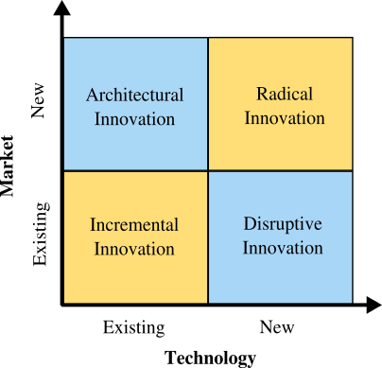
Types of Innovation

Slide 4
Incremental Innovation
Incremental Innovation is the most common form of innovation. It utilizes your existing technology and increases value to the customer (features, design changes, etc.) within your existing market. Almost all companies engage in incremental innovation in one form or another

Slide 5
Disruptive Innovation
Disruptive innovation, also known as stealth innovation, involves applying new technology or processes to your company’s current market. It is stealthy in nature since newer tech will often be inferior to existing market technology. This newer technology is often more expensive, has fewer features, is harder to use, and is not as aesthetically pleasing. It is only after a few iterations that the newer tech surpasses the old and disrupts all existing companies. By then, it might be too late for the established companies to quickly compete with the newer technology.

Slide 6
Architectural Innovation
Architectural Innovation
Architectural innovation is simply taking the lessons, skills and overall technology and applying them within a different market. This innovation is amazing at increasing new customers as long as the new market is receptive. Most of the time, the risk involved in architectural innovation is low due to the reliance and reintroduction of proven technology. Though most of the time it requires tweaking to match the requirements of the new market.

Slide 7
Radical Innovation
Radical innovation is what we think of mostly when considering innovation. It gives birth to new industries (or swallows existing ones) and involves creating revolutionary technology. The airplane, for example, was not the first mode of transportation, but it is revolutionary as it allowed commercialized air travel to develop and prosper.

Slide 8
5 Requirements of an Innovative Company
Employees who’ve been taught to think like innovators
  Challenge invisible orthodoxies
  Harness underappreciated trends
  Leverage embedded competencies and assets
  Address “unarticulated” needs
A sharp, shared definition of innovation
  To manage innovation in a systematic way, you have to have a widely understood definition of innovation. Without this, it’s impossible to know how much “real” innovation is going on and whether it’s paying off. Just as critically, you can’t hold leaders responsible for innovation if no one can agree on what’s innovative and what’s not.

Slide 9
Requirements continued
Comprehensive innovation metrics
  Companies measure just about everything that has an impact on the bottom line, yet strangely, they often shy away from measuring innovation. Granted, it is difficult to measure. Historical benchmarks are of limited value when a product has no antecedents, and it’s hard to pin down the future value of an idea that exists only as a concept.

Slide 10
Requirements continued
  A Dashboard for Metrics should include
    Inputs
    Throughputs
    Outputs
    Leadership
    Competence of employees
    Climate
    Efficiency
    Balance

Slide 11
Requirements continued
Accountable and capable innovation leaders
  What percentage of the leaders in your company, from project managers to execu­tive vice presidents, are formally accountable for innovation? What percentage have innovation-related targets that affect their compensation? If it’s anything less than 100%, innovation will be marginalized. Too often innovation is seen as the province of specialized units like R&D or corporate business development, rather than being the responsibility of every leader at every level.
Innovation-friendly management processes

Slide 12
Innovation and Entrepreneurship
An innovative entrepreneur can create a start-up company that has the capacity to grow quickly
Be sure to leverage technology
Be passionate about what you are trying to do
Have a plan, work the plan

