Slide 1
Instructor and Student Artwork
Donna Colebeck
Lecturer of Studio Art
School of Art and Design
College of the Arts
Kennesaw State University

Slide 2
Donna Colebeck, MFA
Photography
Metals
Painting
Drawing

Slide 3
“Antique Bottles”, Photography Juried Museum Exhibit Academe/Academia January 2016

Slide 4
“Rocking Mist”, Photography Juried Museum Exhibit Metro Montage June 2015

Slide 5
“Leaves”, Digital Photography

Slide 6
“Spring”, Digital Photography

Slide 7
“Chimney”, Digital Photography

Slide 8
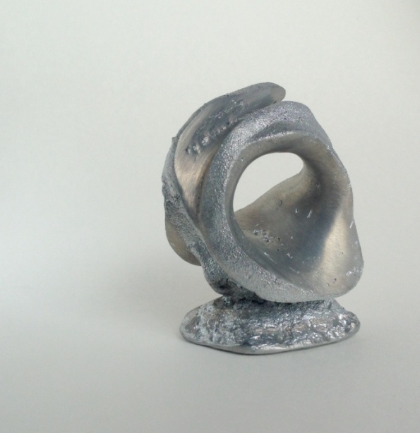
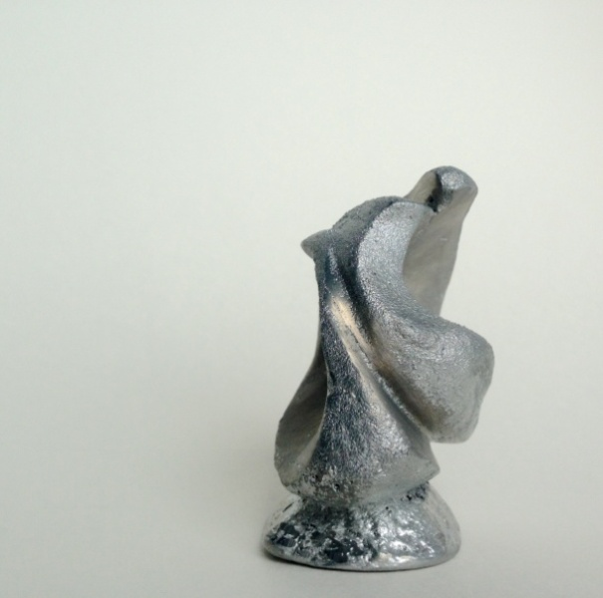
“What Goes Around”, Zink Casting

Slide 9
“Teapot”, MFA Thesis work

Slide 10
“Thendara Station”, Watercolor

Slide 11
“River Kayak”, Watercolor

Slide 12
“Streetscape”, Acrylic

Slide 13
“Noise”, Acrylic

Slide 14
“Moose River Rocks”, Acrylic

Slide 15
“Pears”, Oil

Slide 16
“Portrait”, Oil

Slide 17
“Portrait”, Watercolor

Slide 18
“Model”, Conte

Slide 19
“Boots”, Graphite

Slide 20
Student Work
Drawing
Painting
2D
3D
3D Printing

Slide 21
“Berry Mill”, Graphite

Slide 22
“Darth”, Graphite

Slide 23
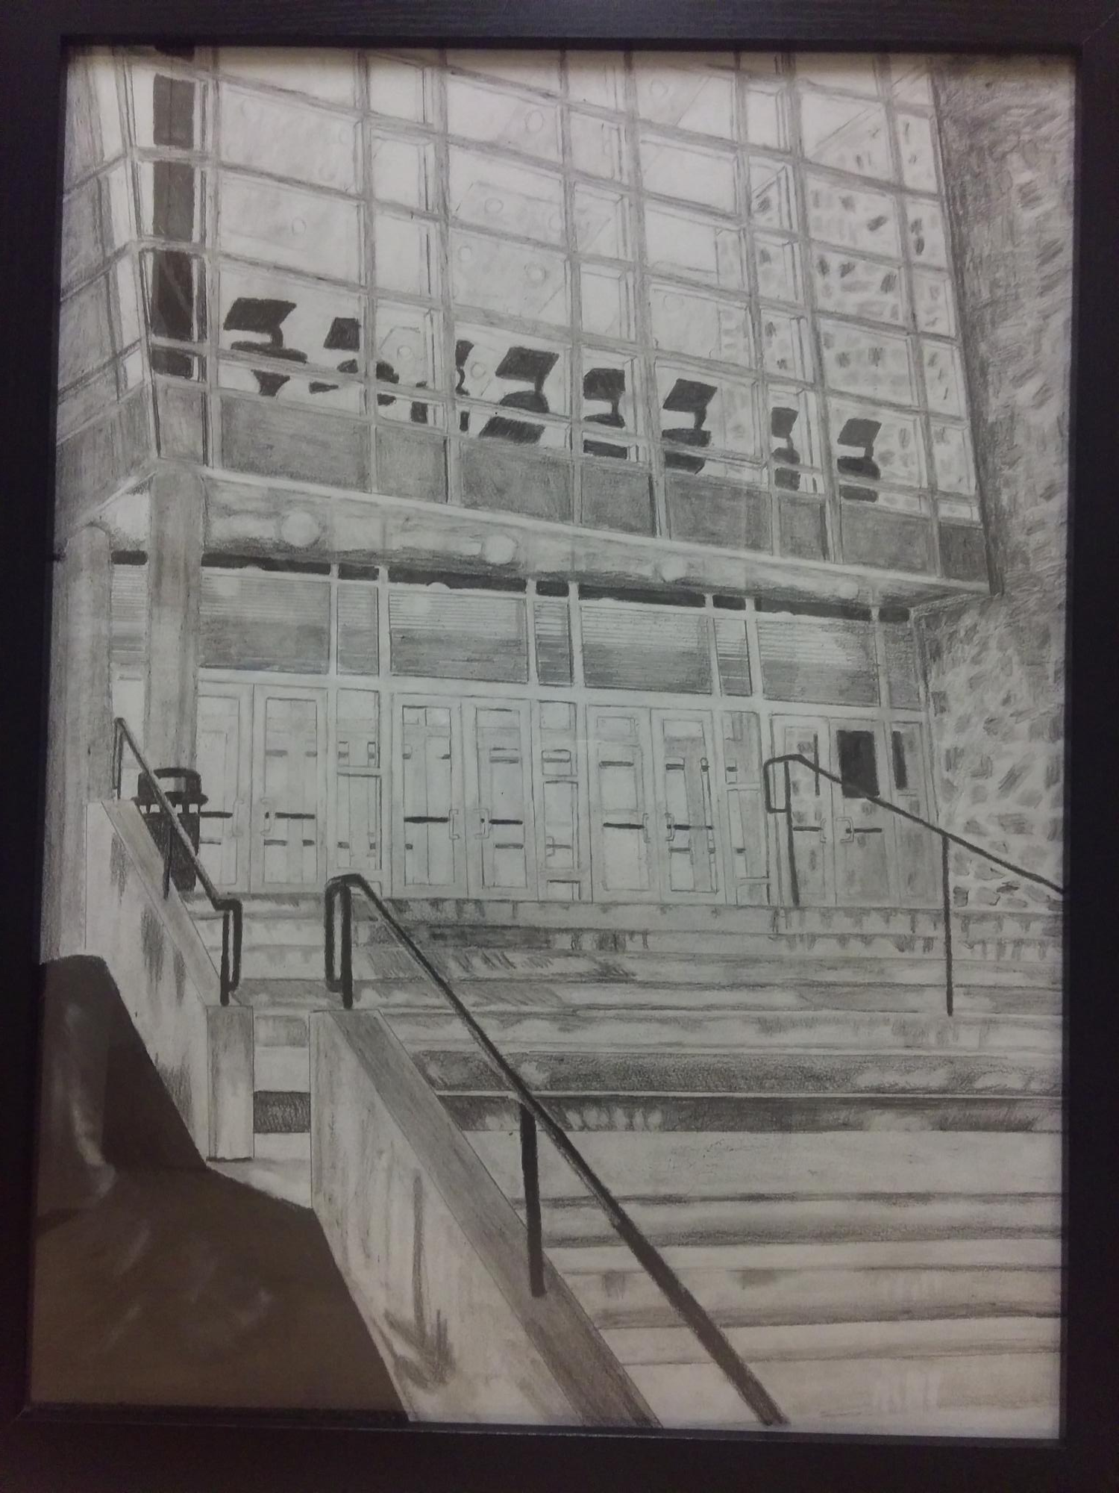
“KSU Night”, Graphite

Slide 24
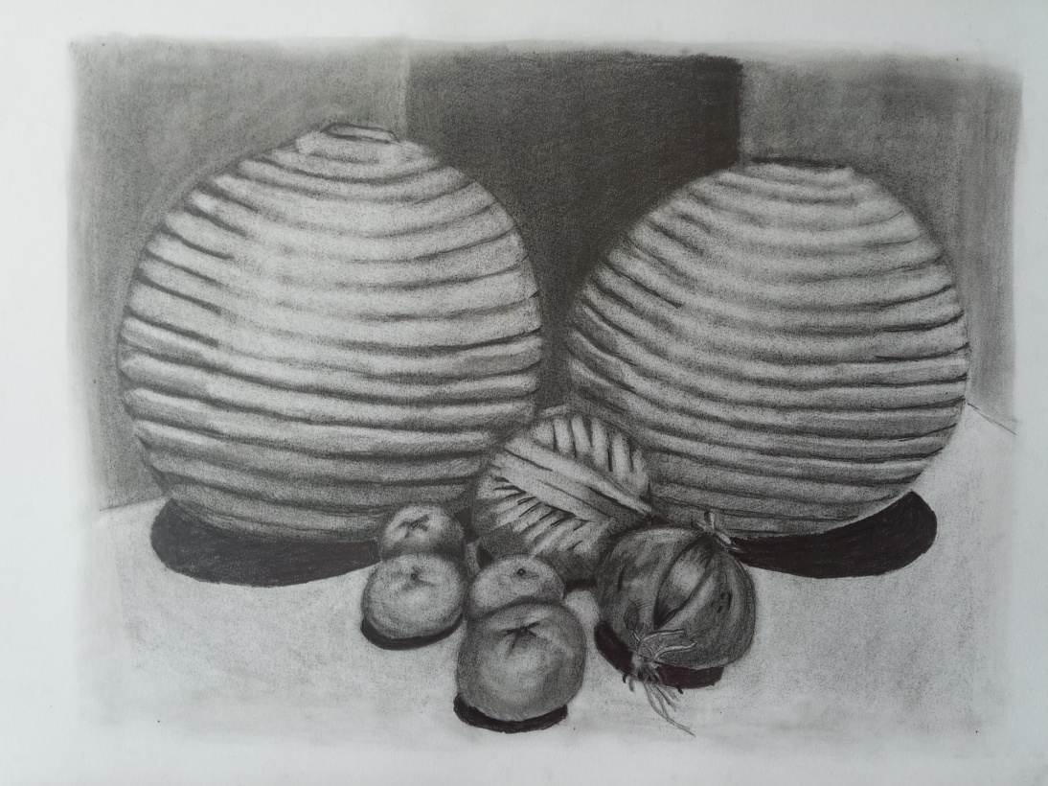
“Orb Study”, Graphite

Slide 25
“Controller”, Graphite

Slide 26
“Twins”, Graphite

Slide 27
“Self Portrait”, Graphite

Slide 28
“Reveal”, Graphite

Slide 29
“Mannequins”, Graphite

Slide 30
“Boots”, Graphite

Slide 31
“Pulley”, Charcoal & Conte

Slide 32
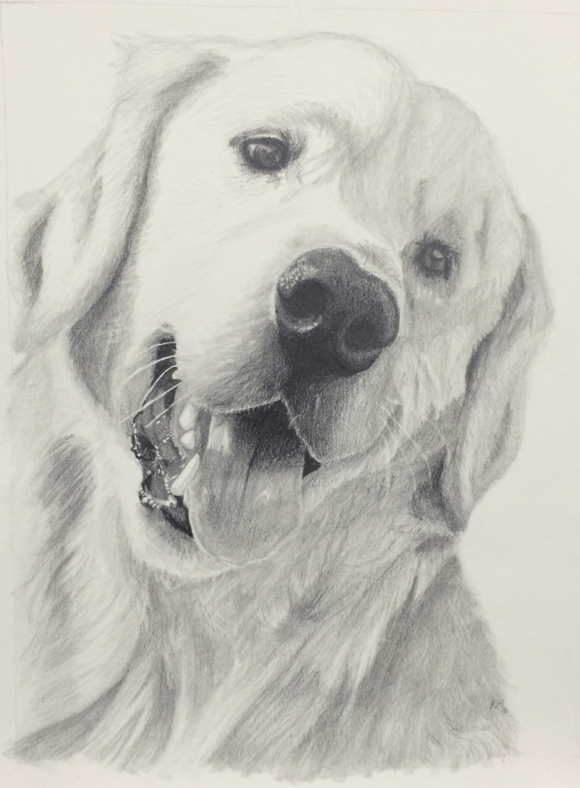
“My Pet”, Graphite

Slide 33
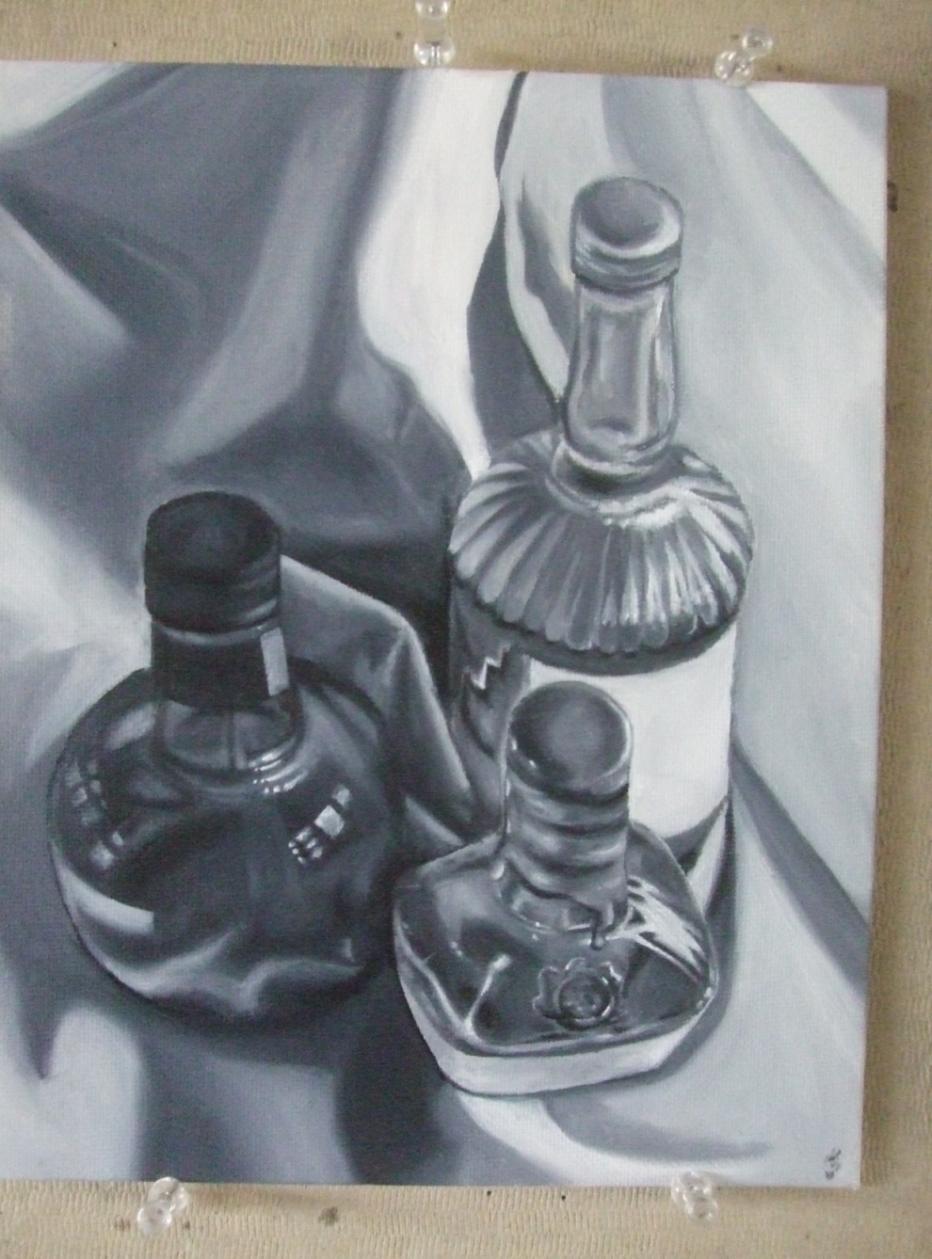
“Bottles Study Tone”, Painting

Slide 34
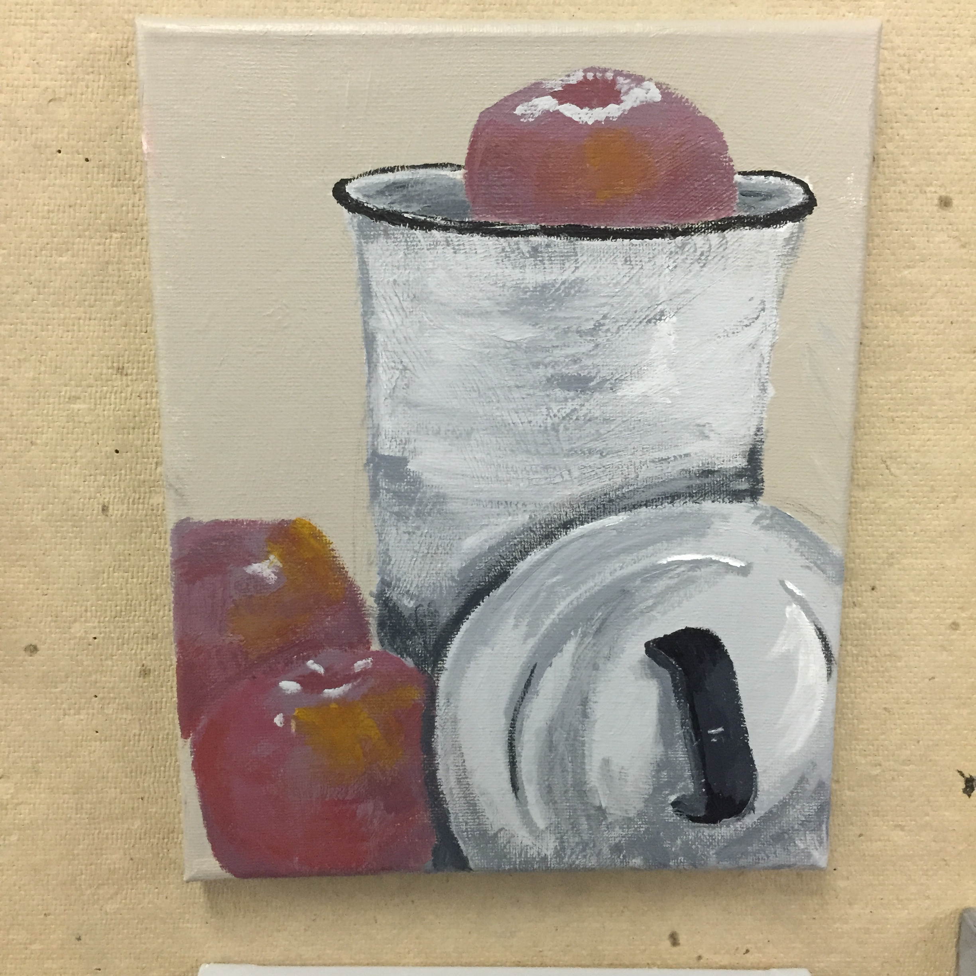
“Apples”, Acrylic

Slide 35
2D Design & Color Theory, Painting

Slide 36
2D Design, Digital Art

Slide 37
“2D Design & Color Theory, Pen

Slide 38
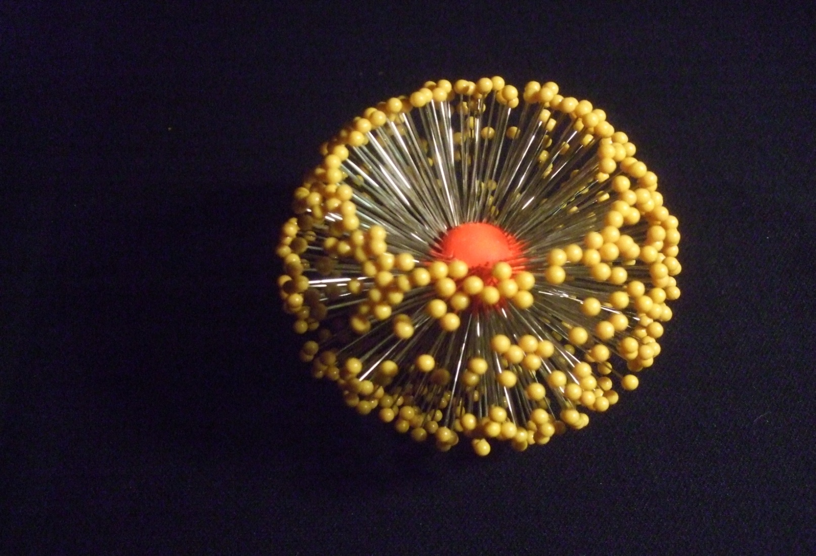
3D Design Pin Sculpture

Slide 39
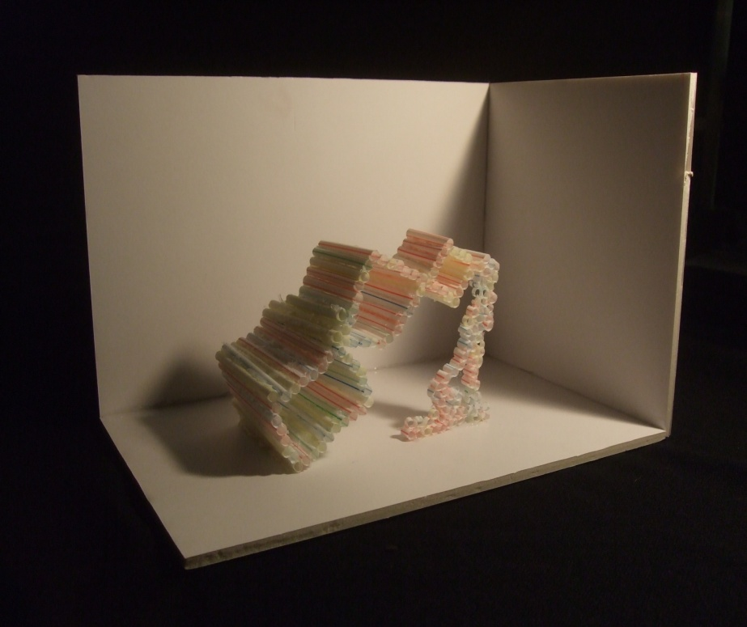
3D Marquette Installation Sculpture

Slide 40
2D & 3D Design; 3D Printing

